Slide 1
Posture Perfect Group - 8 Data Analytics using Deep Learning
Vinayak Joshi Sonali Singh
Srishti Nanduri Siddhesh Vanikar
Satwik Reddy Amlan Mishra
Image courtesy: fix.com

Slide 2
Outline
Background and context
Business Model
The Model
Research Papers
Challenges we face

Slide 3
Our Aim
Background & Context
Objective is to make fitness freely and ubiquitously available for all.
Our model aims to evaluate the users posture using webcam and outputs the accuracy with which the user is performing the exercise giving the image of an ideal person preforming, this eliminates the necessity of having a trainer.
Our model makes the need to go to a gym to achieve fitness goals a mere task which one could do in the comfort of their homes.

Slide 4
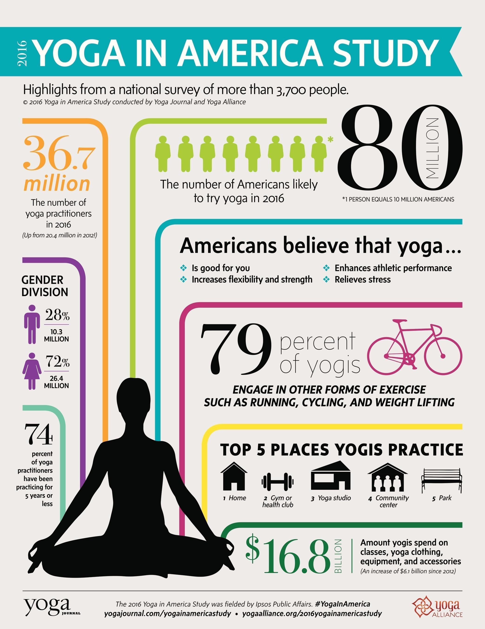
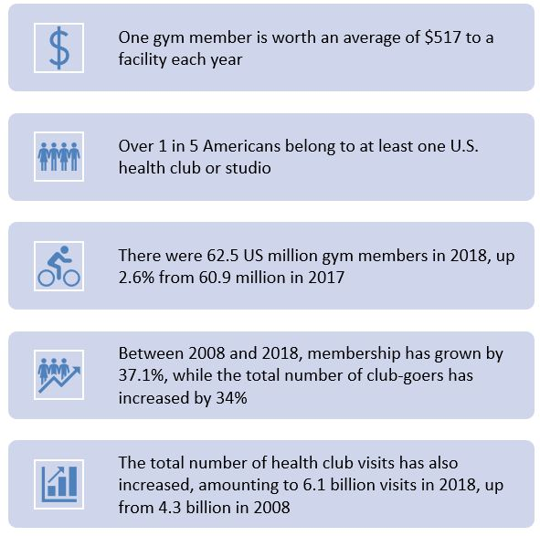
Some Surveys
Background and Context
Source: 2016 Yoga in America Study Conducted by Yoga Journal and Yoga Alliance; Health and Fitness Marketing – Trends and Statistics for 2019 by V12 data

Slide 5
Why is right posture so important?
Background and Context
Source: The Ultimate Exercises to Improve Posture (Simple and Effective) – lifehack.org

Slide 6
Outline
Background and context
Business Model
The Model
Research Papers
Challenges we face

Slide 7
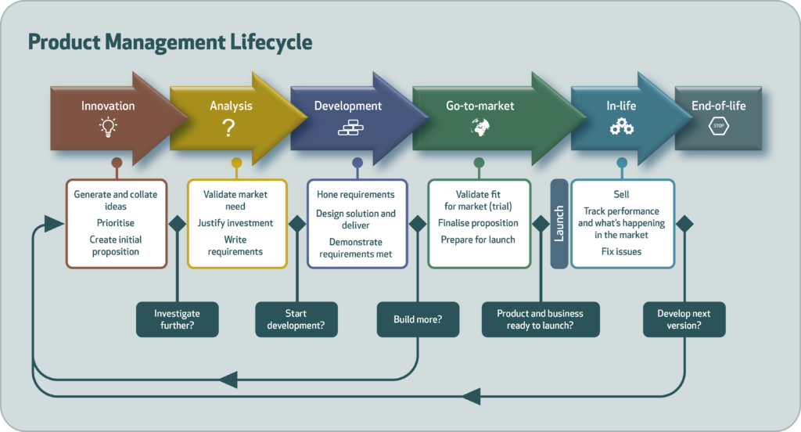
Product Management Lifecycle
Business Model
Source: https://www.productfocus.com/

Slide 8
Product Management Lifecycle
Business Model
1/5
In-life
Innovation
Making achieving fitness goals easier for people around the globe by using deep learning model
Go-to-market
Analysis
Development

Slide 9
Product Management Lifecycle
Business Model
2/5
In-life
Innovation
By Analysing the demographics using K-means clustering, we plan to target the audience which is most likely to adapt to our model.
Go-to-market
Analysis
Development

Slide 10
Determining the proportion of people going to gym frequently
Business Model
2/5
We have collected a dataset from Kaggle which contains the information of people going to the gyms. The analysis is done on the number of people column, time spent in the gym.
On analyzing the data we applied K-Means clustering to classify the certain groups of people. Then on visualizing the graph we would get to know the group/cluster of people going to gym most frequently.
On the basis of this we would then focus on those group of people who frequently go to gym, in order to initiate our business model.

Slide 11
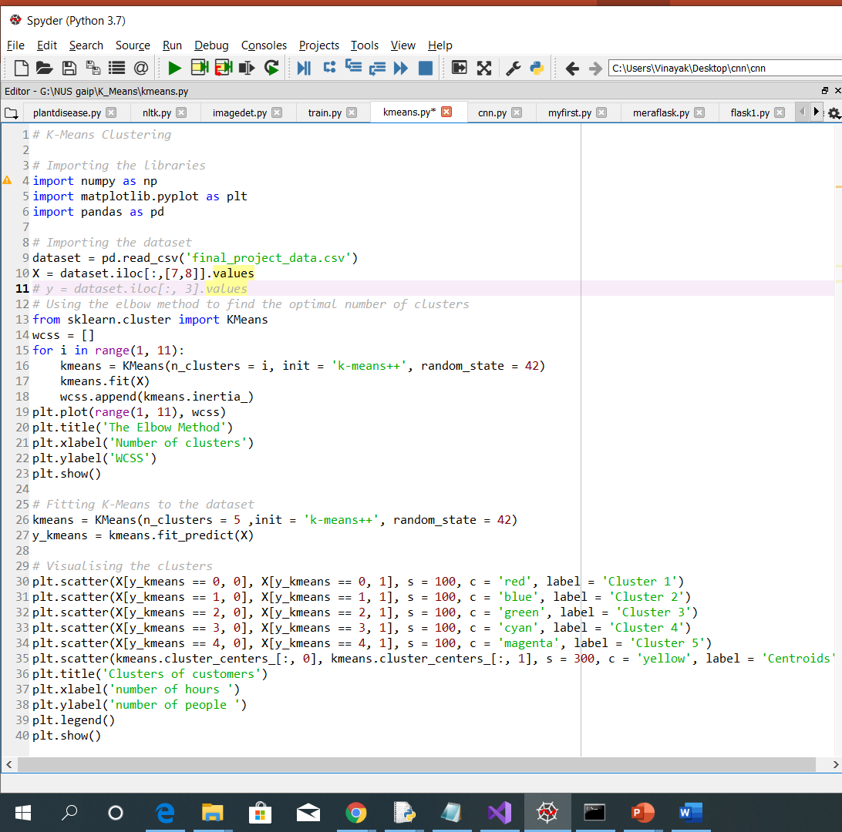
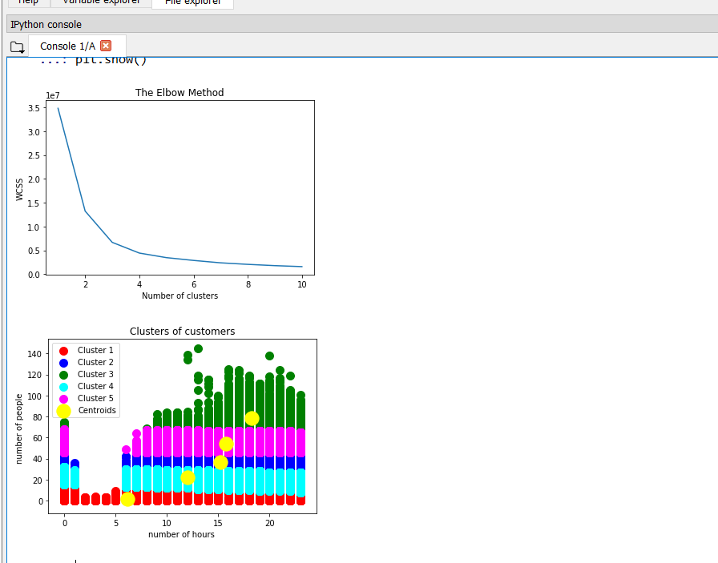
K-Means Code and Output
Business Model
2/5
Code Snippet
Output

Slide 12
Product Management Lifecycle
Business Model
3/5
In-life
Innovation
We used VGG to classify the exercise performed by the user and Softmax function to provide the accuracy with which the exercise was performed.
Go-to-market
Analysis
Development

Slide 13
Product Management Lifecycle
Business Model
4/5
In-life
Innovation
Develop a website/app for deploying a model
Go-to-market
Analysis
Development

Slide 14
Product Management Lifecycle
Business Model
5/5
In-life
Innovation
In real time, multiple 2D cameras could be used for extracting images of multiple frames in order to analyse the 3D human model.
Go-to-market
Analysis
Development

Slide 15
Outline
Background and context
Business Model
The Model
Research Papers
Challenges we face

Slide 16
Data Preparation
The Model
We used the crawler to mine data for 4 classes, but it was giving us repeated images.
So we used different keywords to get images of the same class. Example: For getting images for class ‘Pushups’, we used keywords such as ‘Pushup_Men’ and ‘Pushup_Women’ so that our data set is unbiased.
We also got images that were completely unrelated to our classes, hence we removed them manually to get the clean dataset.
We have 2000+ total images with approximately 500+ images per class

Slide 17
The VGG
The Model
Dropout
Conv2D
Max Pooling
Flatten
Dense Sigmoid
Batch N.
Dense Softmax
ReLU
Dropout
Conv2D
ReLU
Dropout
Conv2D
ReLU
Dropout
Max Pooling
Dropout
Conv2D
ReLU
Dropout
Max Pooling
Dropout
Conv2D
ReLU
Dropout
Conv2D
ReLU
Dropout
Max Pooling
Dropout

Slide 18
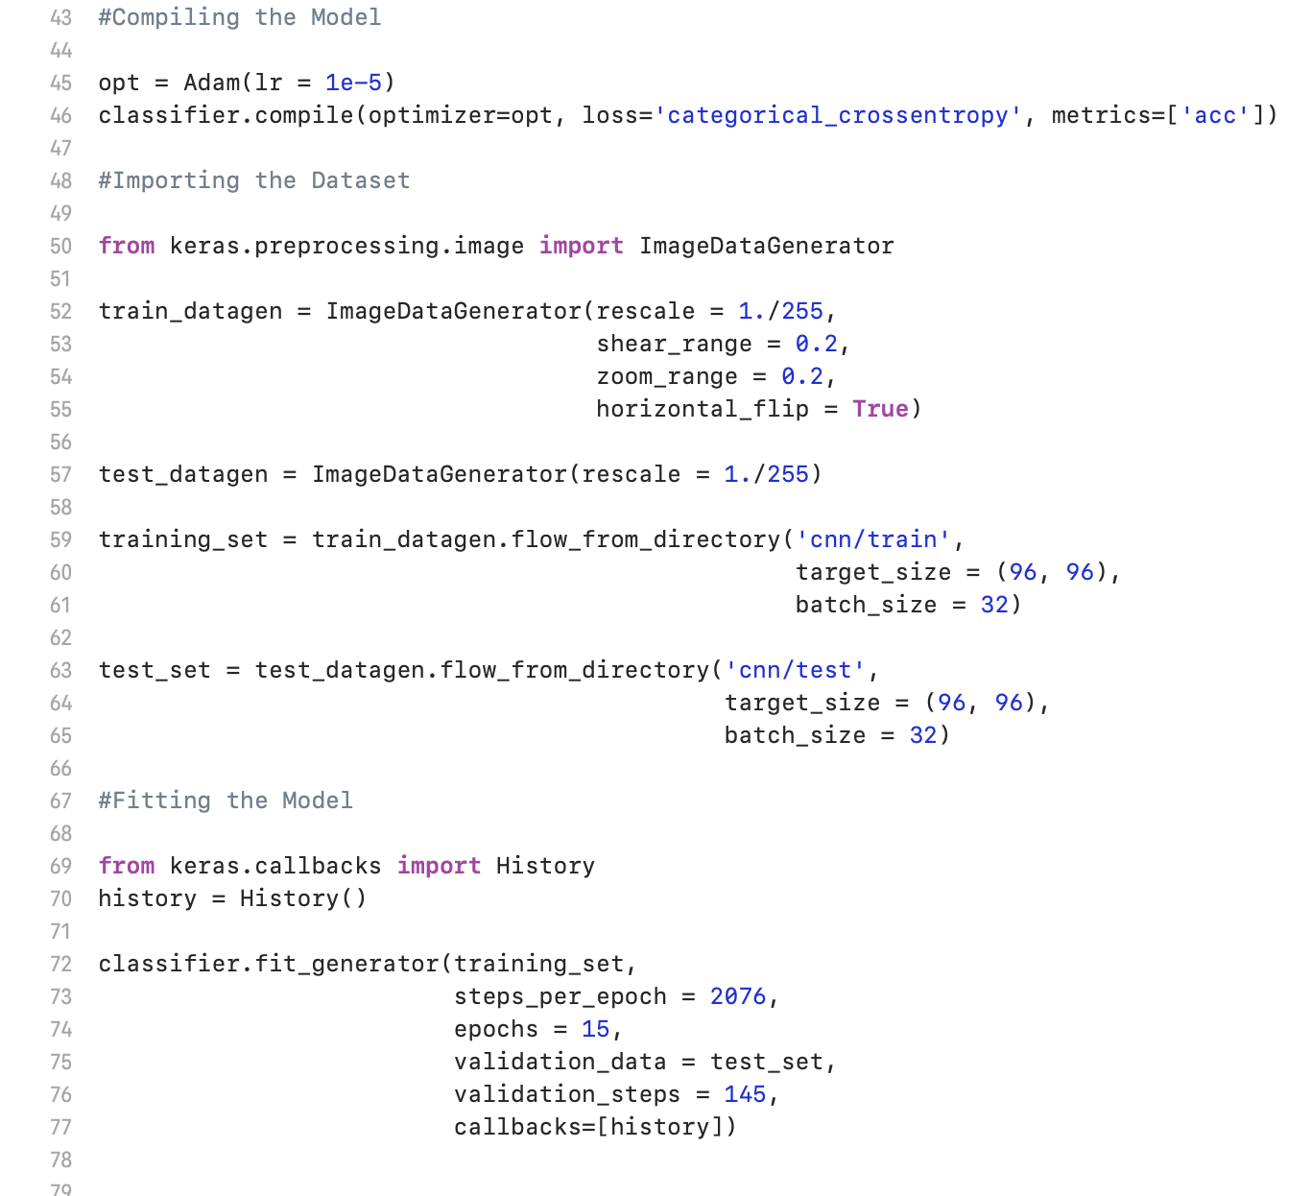
The VGG
The Model

Slide 19
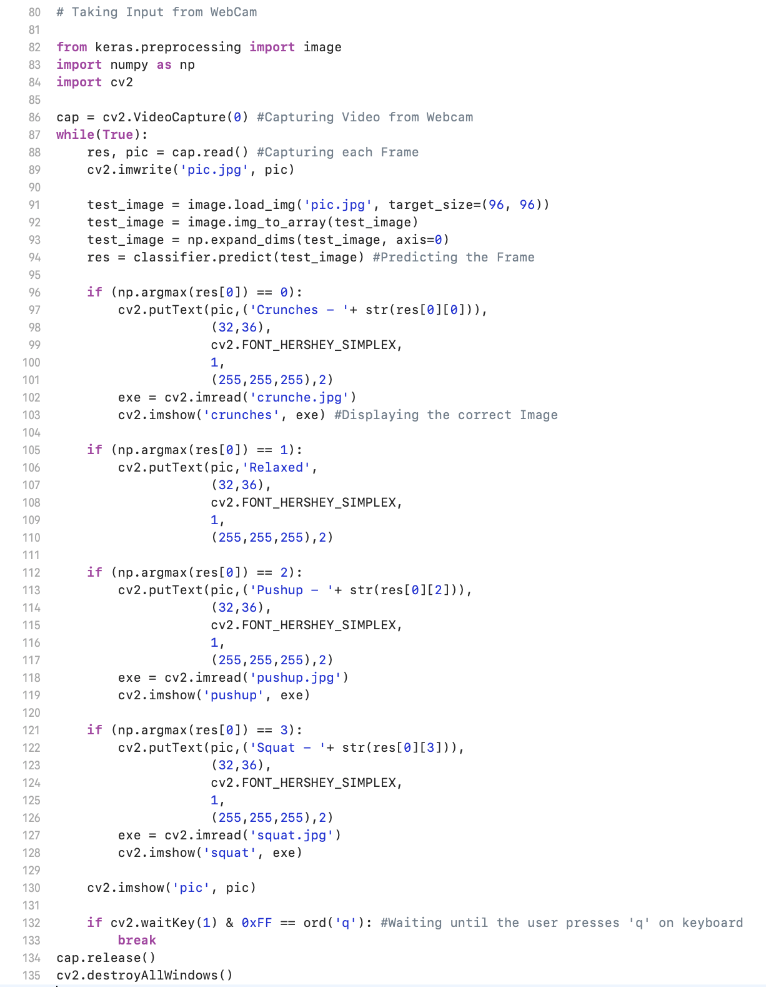
The VGG
The Model

Slide 20
The VGG
The Model

Slide 21
The VGG
The Model

Slide 22
Tuning Hyperparameters
The Model
Learning Rate – 10^-5
Batch Size – 32
Epochs - 15

Slide 23
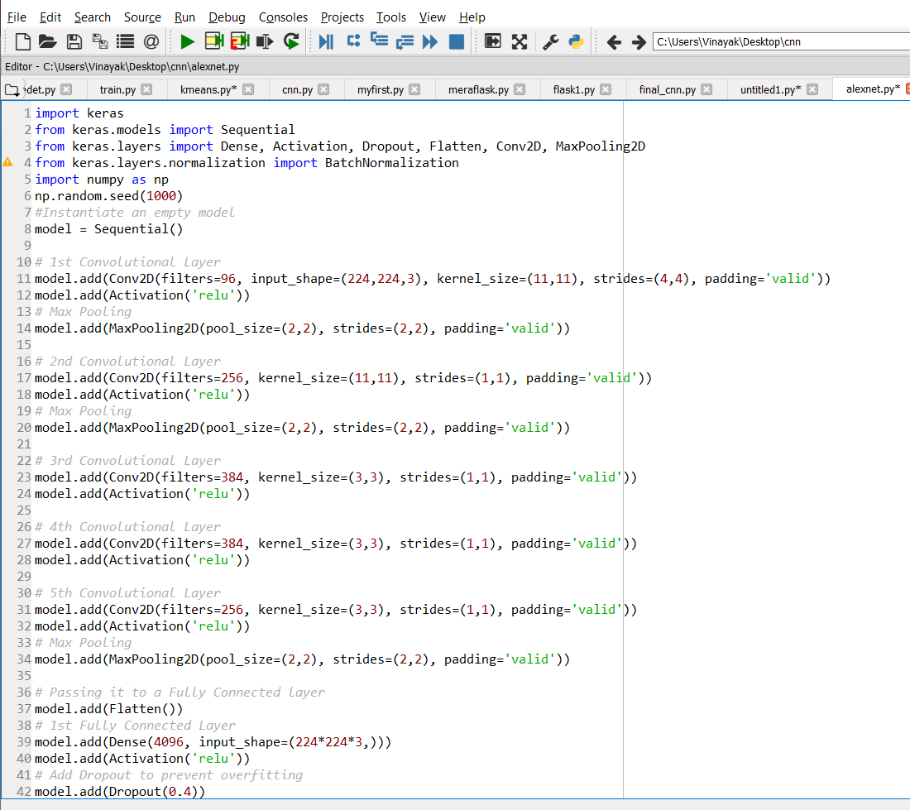
Other Models: AlexNet
The Model

Slide 24
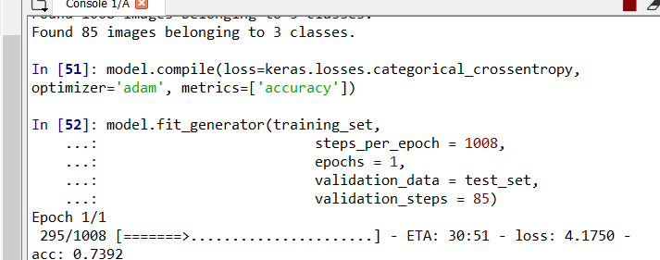
Other Models: AlexNet
The Model

Slide 25
Summary
The Model
A number of comparisons can be drawn:
Instead of using large receptive fields like AlexNet (11x11 with a stride of 4), VGG uses very small receptive fields (3x3 with a stride of 1). Because there are now three ReLU units instead of just one, the decision function is more discriminative. There are also fewer parameters (27 times the number of channels instead of AlexNet’s 49 times the number of channels).
The small-size convolution filters allows VGG to have a large number of weight layers; of course, more layers leads to improved performance. GoogLeNet, another model that uses deep CNNs and small convolution filters, was also showed up in the 2014 ImageNet competition.
AlexNet is very slow and takes a lot of computational time to run but supposedly gives relatively better accuracy w.r.t. VGG

Slide 26
Outline
Background and context
Business Model
The Model
Research Papers
Challenges we face

Slide 27
Posture recognition using RGB-D camera: Exploring 3D body modeling and deep learning
Research Papers
In this research paper the proposed method is based on using 2D images representing human postures to adapt a pretrained CNN for the speciﬁc recognition problem. Posture recognition is a central problem in computer vision, with a wide range of applications such as human-machine interaction, content-based video annotation, and especially intelligent video surveillance systems for ambient assisted living.
This paper aims to explore several acquisition possibilities offered by an RGB-D camera to design novel methods and ideas for automatic posture recognition.
They have used the Alex Net network that has been pre-trained from the ImageNet database to classify images into 1000 object categories. Before using posture images to retrain the network, their dataset is ﬁrst pre-processed by resizing the images according to the CNN input format and subtracting the background to extract the body silhouette.

Slide 28
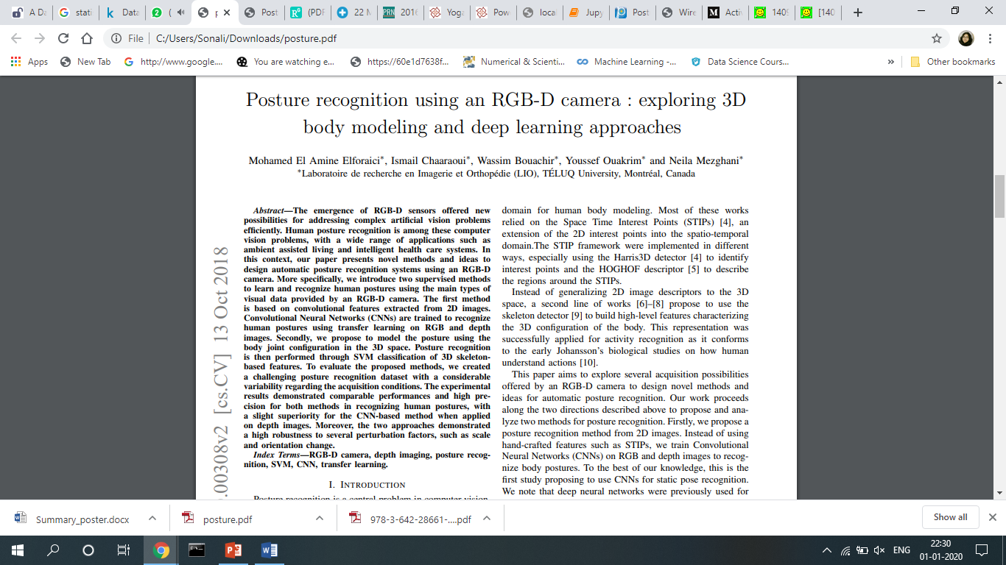
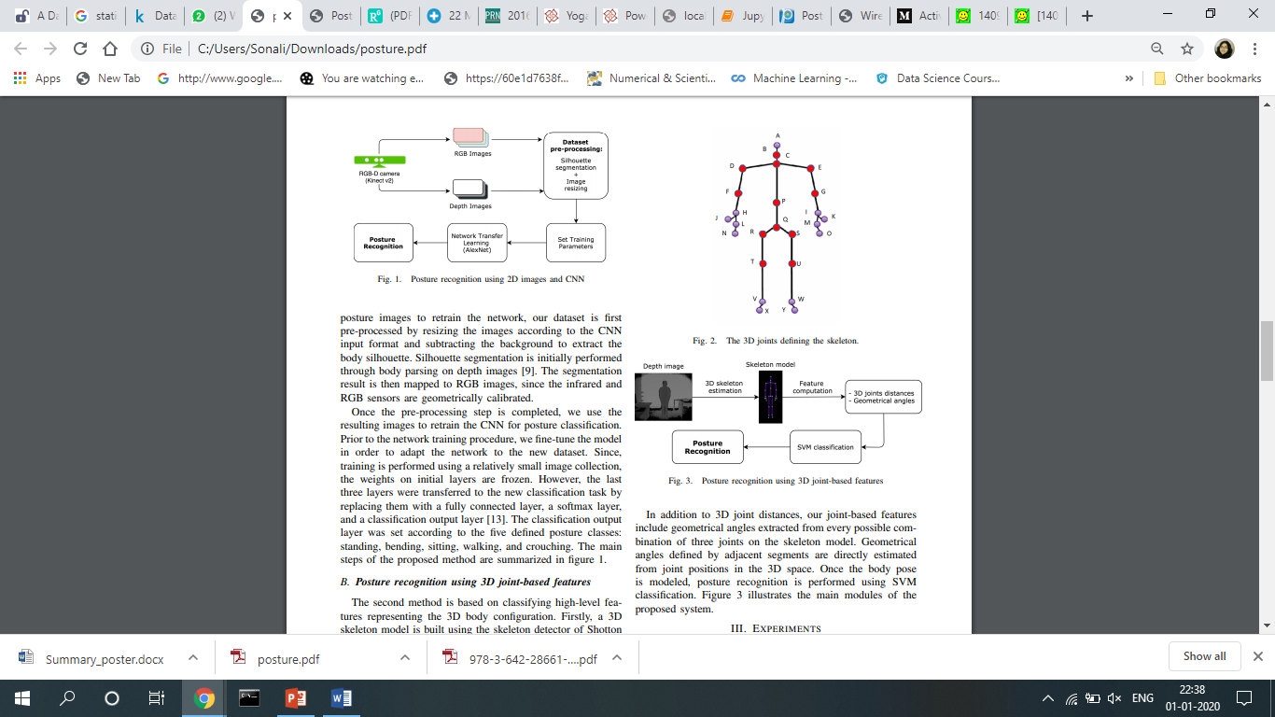
Posture recognition using RGB-D camera: Exploring 3D body modeling and deep learning
Research Papers

Slide 29
Posture recognition using RGB-D camera: Exploring 3D body modeling and deep learning
Research Papers
Once the pre-processing step is completed, they used the resulting images to retrain the CNN for posture classiﬁcation. Prior to the network training procedure, they ﬁne-tune the model in order to adapt the network to the new dataset.
Hence they mainly designed two methods by exploiting different types of visual data provided by an RGB-D camera. The ﬁrst method was based on CNN classiﬁcation of 2D images, while the second uses 3D body modeling to compute and classify high level features.
The proposed methods were validated on a challenging posture recognition dataset released in their laboratory.

Slide 30
Posture Recognition with a 3D Human model
Research Papers
This paper deals with the concept of using 2D input to analyze the 3D structure of human body by projecting the moving pixels on the reference axis.
Some particular postures were considered like sitting posture, standing posture, bending posture, etc. in which detection was done by subtracting current image with respect to reference image in order to obtain binary output image.

Slide 31
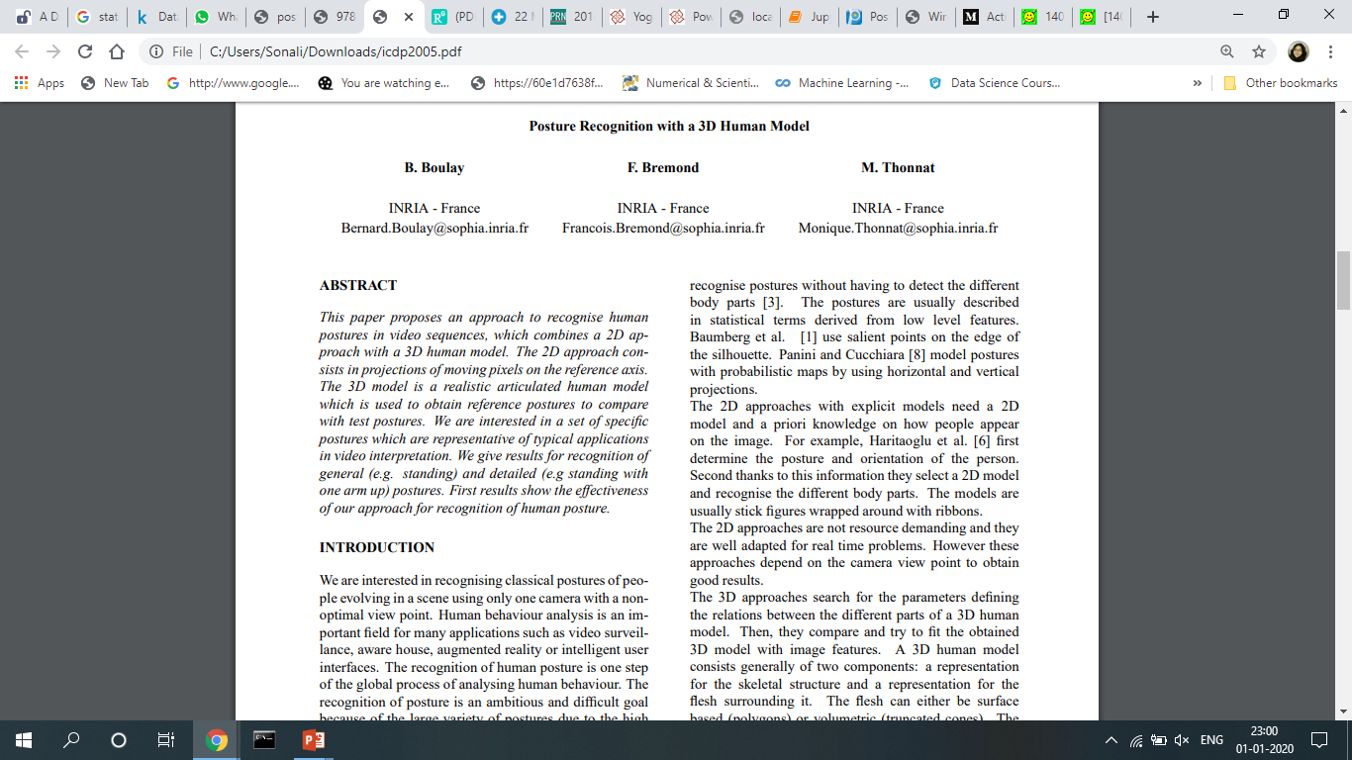
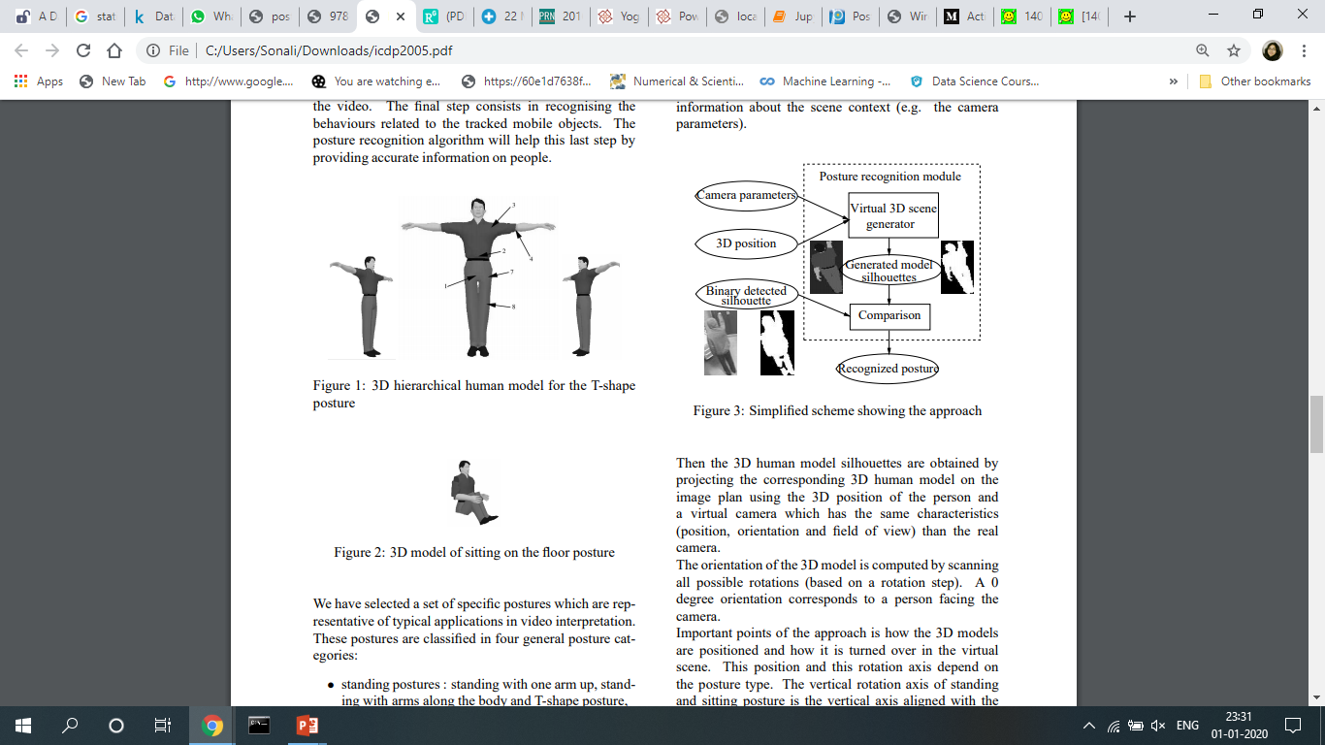
Posture Recognition with a 3D Human model
Research Papers

Slide 32
Posture Recognition with a 3D Human model
Research Papers
For each detected person, first the 3D position are computed using different information about the scene context.
Then the 3D human model silhouettes are obtained by projecting the corresponding 3D human model on the image plan using the 3D position of the person.
Thus, all orientations are taken into account by scanning all the rotation positions.

Slide 33
Real-Time Human Pose Recognition in Parts from Single Depth Images
Research Papers
This chapter describes a method to quickly and accurately predict 3D positions of body joints from a single depth image, using no temporal information. They took an object recognition approach, designing an intermediate body parts representation that maps the difﬁcult pose estimation problem into a simpler per-pixel classiﬁcation problem.
Robust interactive human body tracking has applications including gaming, human computer interaction, security, telepresence, and even health-care. The task has recently been greatly simpliﬁed by the introduction of real-time depth cameras [16, 19, 44, 37, 28, 13].
They treat the segmentation into body parts as a per-pixel classiﬁcation task (no pairwise terms or CRF have proved necessary). Evaluating each pixel separately avoids a combinatorial search over the different body joints, although within a single part there are of course still dramatic differences in the contextual appearance.

Slide 34

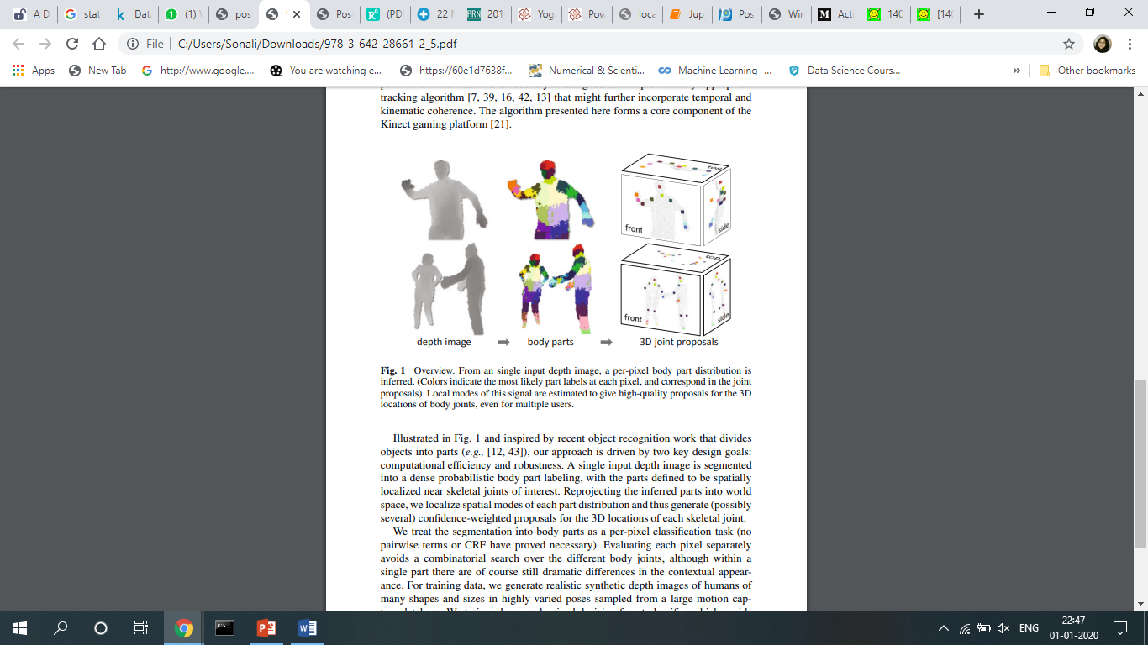
Real-Time Human Pose Recognition in Parts from Single Depth Images
Research Papers

Slide 35
Real-Time Human Pose Recognition in Parts from Single Depth Images
Research Papers
For training data, they generate realistic synthetic depth images of humans of many shapes and sizes in highly varied poses sampled from a large motion capture database.
They train a deep randomized decision forest classiﬁer which avoids overﬁtting by using hundreds of thousands of training images.
Simple, discriminative depth comparison image features yield 3D translation invariance while maintaining high computational efﬁciency.

Slide 36
Outline
Background and context
Business Model
The Model
Research Papers
Challenges we face

Slide 37
Advantages of the model
Challenges we face
With the deployed model we can achieve our fitness goals in the comfort of our home.
We can compete with our friends all over the globe encouraging people to adapt to healthier lifestyles, leading to more productive world.
It will serve as a replacement to trainers in gyms.

Slide 38
Limitations of the model
Challenges we face
We have used 2D images as input instead of considering 3D model of human being.
A better implementation of this model would be tracking the movement of various points of the body.
The training dataset doesn’t contain professional trainers performing the exercise. So there will be some error in the accuracy measured.

Slide 39
References
https://www.researchgate.net/publication/330226753_Posture_Recognition_Using_an_RGB-D_Camera_Exploring_3D_Body_Modeling_and_Deep_Learning_Approaches
https://ieeexplore.ieee.org/document/5995316
https://hal.inria.fr/inria-00494244

